Slide 1
Teacher of History
Candidate Information Pack
Required from 1st September 2024
Full Time, Permanent
The closing date for applications is: 9.00am on Friday 10th May 2024

Slide 2
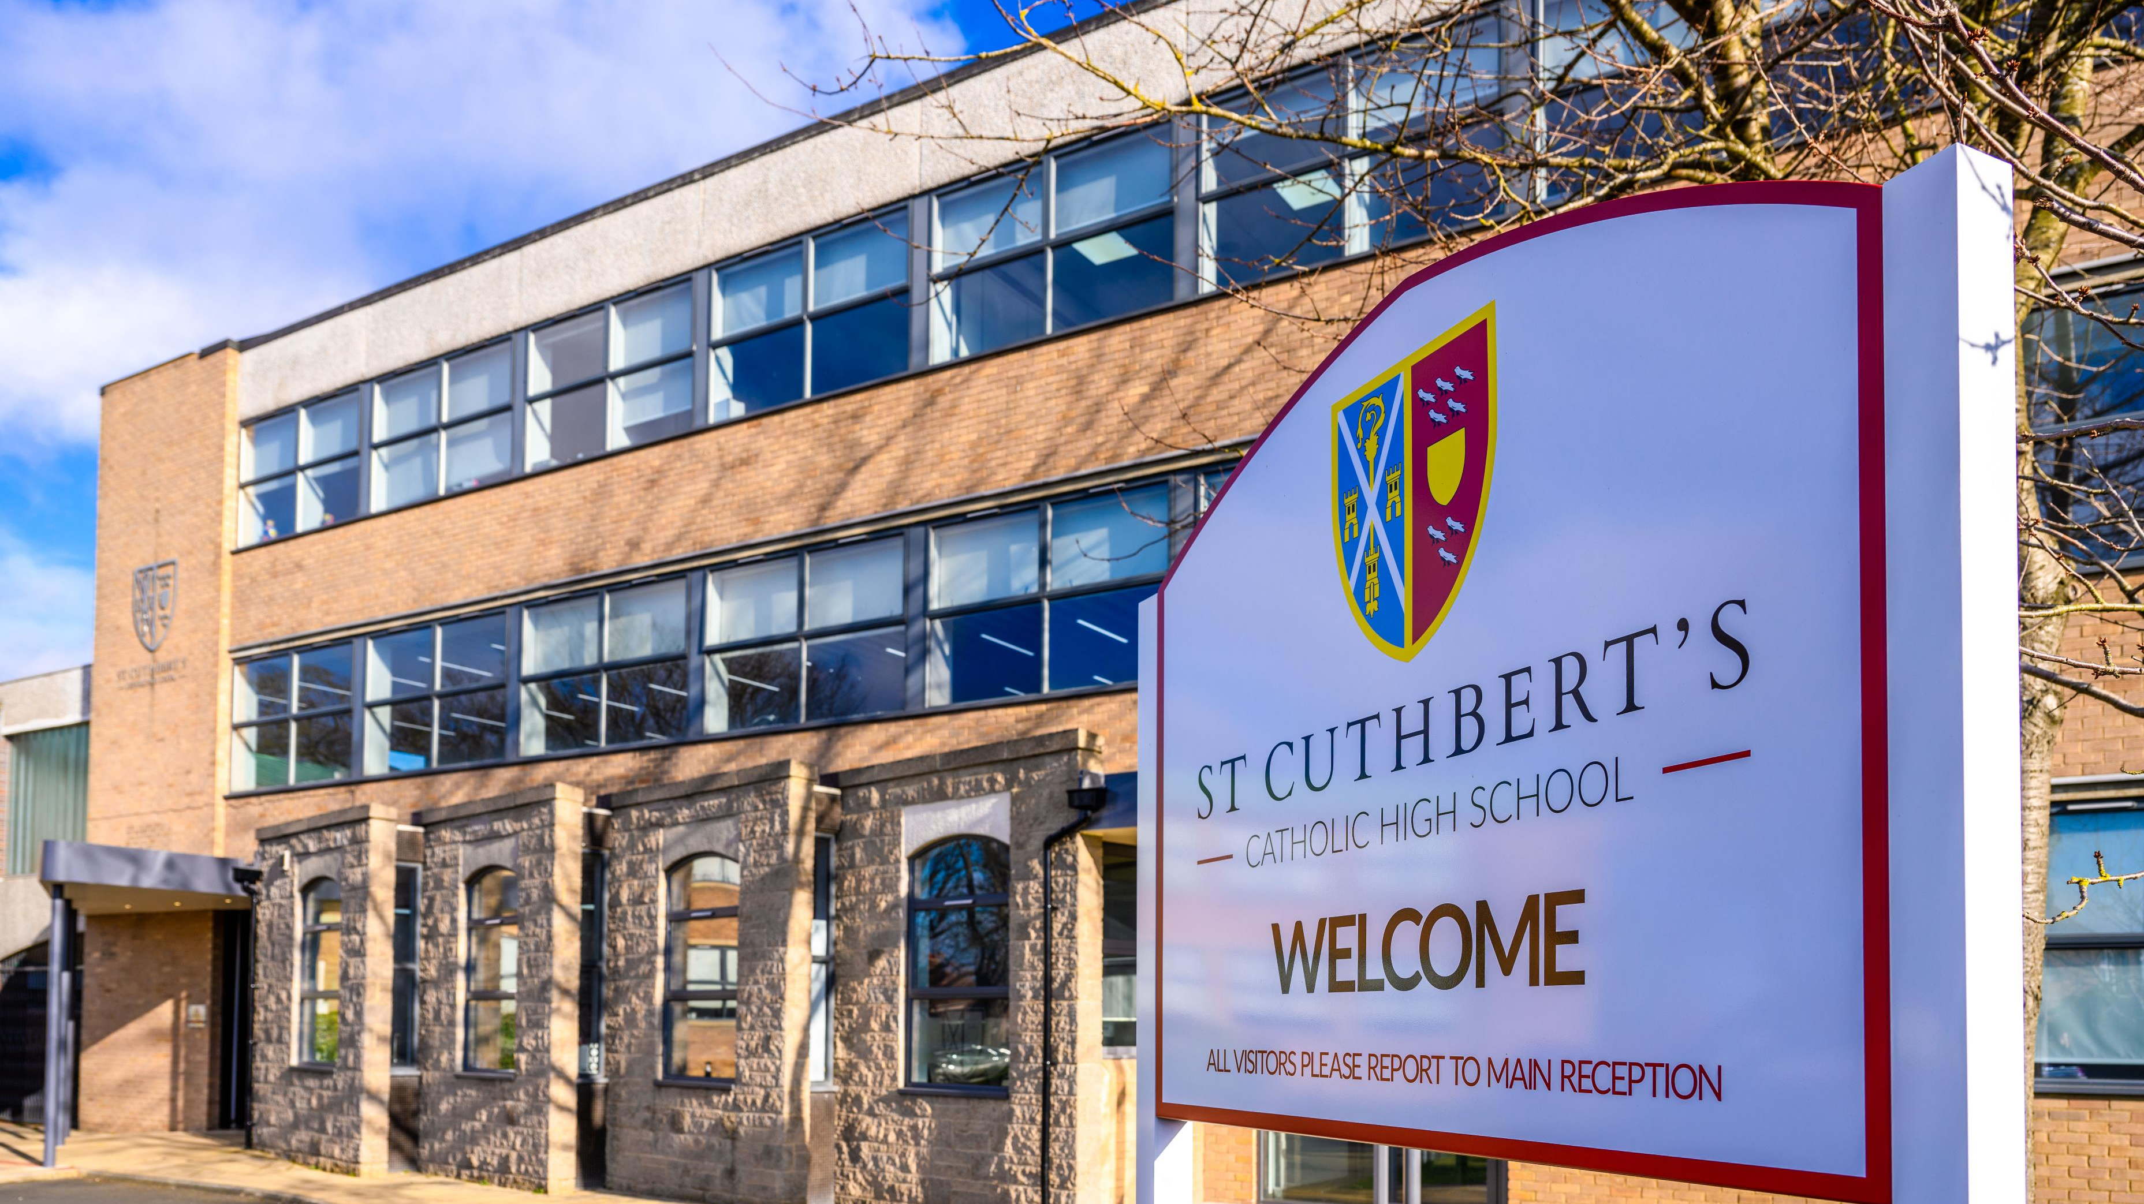
Contents
Welcome to St Cuthbert’s Catholic High School
Our Vision, Mission, and Values
Working in a Catholic school
The Bishop Bewick Catholic Education Trust
The History of St Cuthbert’s
St Cuthbert’s Today
The role
The person
Our commitment to safeguarding and child protection
The application process

Slide 3
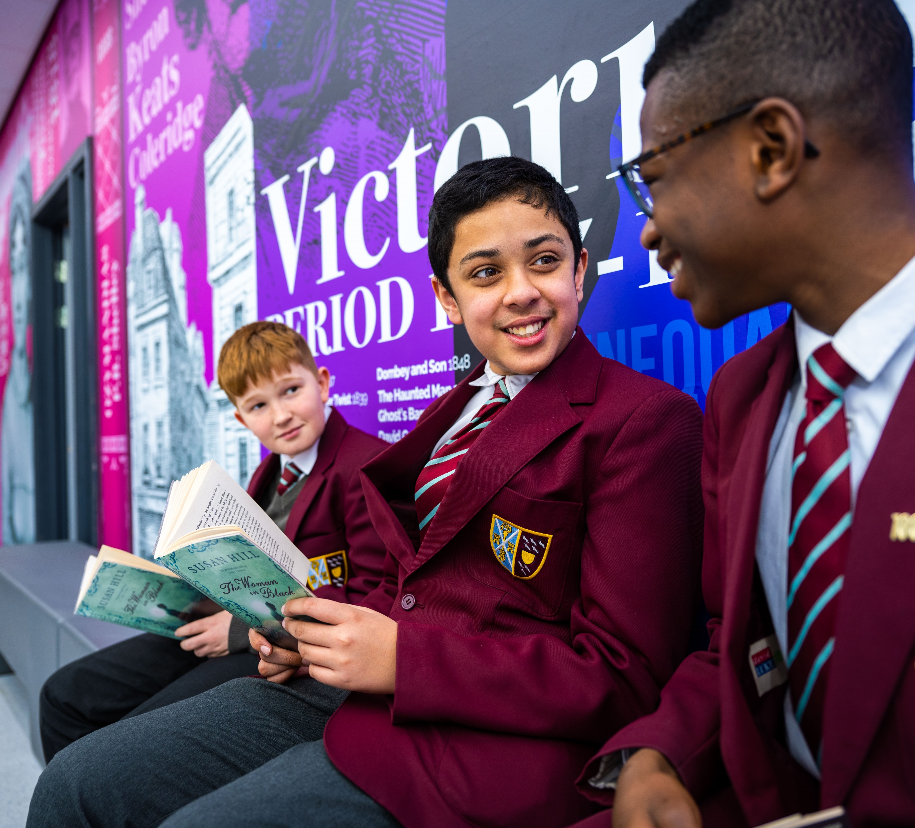
Thank you for your interest in St Cuthbert’s Catholic High School For over one and forty hundred years, St Cuthbert’s has been nurturing fine young men, preparing them to take their rightful place in the Church and in the world. We have provided our pupils and students with a challenging yet supportive environment within which to discover and develop their own God-given gifts.
There are great schools of all kinds. The experience of working in a school like St Cuthbert’s is made distinctive by our expertise in educating boys. In a world that demands ambitious action and bold thinking, our vision, mission, and values reflect our responsibility to help to form great men ready to do good in our world. Characterised by a balance of tradition and innovation, we are resolute in our commitment to ‘forming great men’.
Of course, what matters most is the quality of education on offer. We offer a high-quality Catholic education to boys of all faiths and none. St Cuthbert’s is a truly comprehensive school, but the St Cuthbert’s experience is so much more than a comprehensive education. A good test of this is to see the quality and range of destinations that our pupils have the confidence to pursue beyond St Cuthbert’s. We are proud to see our boys progressing to world-class universities and degree apprenticeships, choosing a varied range of courses.
St Cuthbert’s prepares young men to find their God-given calling and answer it with energy and passion. In our school, in our local community and around the world, our young men serve, lead, and strive to make a difference in the lives of others. If you believe that you can contribute to such a community, if you believe that you have the energy, passion, and commitment to help our boys to excel and to become great men, then I look forward to receiving your application.
Daniel P Murray
Headmaster

Slide 4
Values
Faith– to give boys of all faiths and none, a profound, life-changing experience that focuses on God’s unconditional love and a deeper understanding of themselves as persons of faith and confidence in themselves.
Catholic Spirituality– to root students in the Catholic faith and the rich diverse spirituality of the Catholic tradition To focus on loving service to God and neighbour. To discover and share one’s gifts and talents with the world.
Formation of the Whole Person– to thoughtfully and intentionally integrate the fullness of human experience through spiritual, intellectual, emotional, social and physical development.
A World Affirming Perspective– to provide a spiritual dimension which sees creation as good. To promote a dialogue between faith and culture, which fosters the capacity for critical and original thinking. To appreciate the gifts of life.
Diversity– to create and sustain a vibrant, inclusive community reflecting the expansive demographics and rich mixture of Newcastle’s population.
Scholarship– to build a culture of lifelong learning and inquiry through a rigorous and innovative Catholic curriculum.
Service– to be informed by a faith that does justice. To challenge our boys to be “Men for and with Others.” To be in companionship with–and learning from– the disenfranchised, the marginalized and the most in need. To serve as Jesus did.
Leadership– to develop young men who are compassionate, intellectually distinguished and morally courageous. To create young men of integrity who become effective “agents of change” for the world.
Vision
To be a premier Catholic learning community for the 21st century, preparing young men to witness to Christ and so create a world of justice, peace, truth and love.
Mission
St Cuthbert’s Catholic High School is a community gathered together by God, to form fine young men of integrity who will live according to the pattern of life given to us by Jesus Christ. We will strive, through dedication to academic excellence and the formation of the whole person, to form young men of competence, conscience, compassion, and commitment, who, educated in faith and for justice, will live their lives in the service of others.

Slide 5
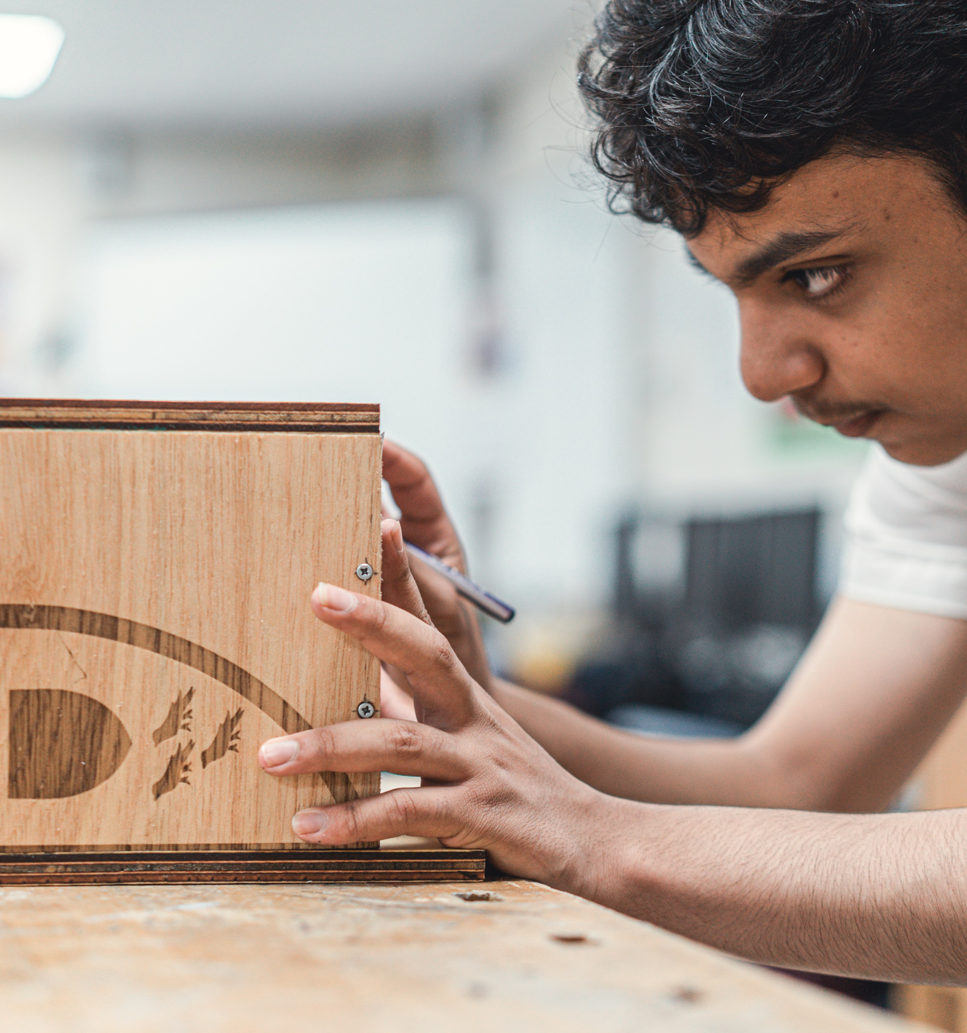
If you come to work in one of the many Catholic schools in the United Kingdom, you will become part of a vibrant and wonderfully rich educational tradition that is centuries old and has global reach. The Catholic Church has, in collaboration with parents, been providing a Catholic education in almost every country in the world, working with millions of young people. As a global organisation with a universal mission, working in a Catholic school will offer you shared goals and a collective mission wherever you find yourself.
Catholic schools are committed to academic excellence and the formation of the whole person. We want every young person to achieve his or her academic potential. However, there is more to being a human being than passing examinations. Catholic schools educate young people in faith, and for justice, so that they might live their lives in the service of others. Our schools are judged not merely by their academic outcomes, but also by how our young people grow to be competent, compassionate, conscientious and committed young adults.
Catholic schools throughout the world share a commitment to helping parents bring up their children, encouraging reflection, prayer, religious commitment, and service to others. In this we are inspired by and faithful to the Gospel of Jesus Christ. We welcome those who are Catholic, from other Christian Churches, and those who belong to other faith or religious traditions or are of no religious tradition.
Anyone who wishes to teach or learn at a Catholic school, must come with an open mind ready to appreciate and learn from the Christian message and that of other traditions.
Why should you become part of a teaching tradition that is centuries old?

Slide 6
The Bishop Bewick Catholic Education Trust
St Cuthbert’s Catholic High School is a proud member of the Bishop Bewick Catholic Education Trust (BBCET). The school joined the Trust on 1st December 2020.
BBCET is one of four Catholic Education Trusts in the Diocese of Hexham and Newcastle. Comprising 39 schools, five secondaries and 34 primary schools, BBCET includes all Catholic schools north of the Tyne and south of the Tweed.
As a member of the Trust, St Cuthbert’s has access to a wider range of support and expertise to continue to develop and improve. Subject networks, high quality professional development and shared resourcing, ensure that we provide an education that can transform lives. ​
BBCET works to ensure that all of the children and young people in our schools experience the best education possible. The Trust is committed, as a community of schools, to come together and harness the very best of ourselves, to embed this fully and to support each other so that all schools thrive and learn.
We are one Trust, and we work as one Trust. However, our schools maintain their individuality, uniqueness, and a great deal of autonomy. BBCET encourages school leaders and staff to be creative and innovate to ensure that we provide the best practice available.
Each school brings skills, strengths, and talents. Each new member of staff joining one of our schools brings skills, strengths and talents. Working together we can enhance the work that we do, offering a great Catholic education to the children and young people that we serve.
​

Slide 7
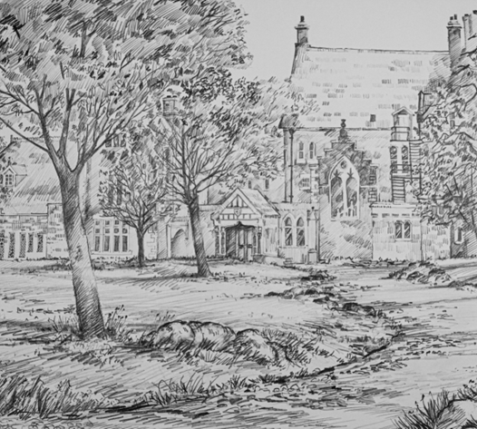
The history of St Cuthbert’s is a cause for genuine pride. Academic achievements and sporting successes in abundance are on record. Our former pupils grace all the professions and make a very valuable contribution to the life of the Church in many parts of the world. On the 16th August 1881, the Right Reverend James Chadwick, Bishop of Hexham and Newcastle, entered the premises of 62-64 Westmorland Road, Newcastle upon Tyne, and proclaimed the opening of St Cuthbert’s Grammar School. The school soon outgrew its central location. The search began for larger more suitable premises to the west of the city. Benwell Hill House, the home of the Westmacott family, came up for sale and was bought together with the grounds which extended to 28 acres. It was in July 1922 that the pupils of the school were told to report after the summer holidays to the new school on Benwell Hill. The new school was officially opened by Cardinal Bourne in September 1922.
In the 1950s, the school began a period of expansion. The curriculum was developed, and new subjects introduced. The site was improved with the refurbishment of one of the old buildings as a biology laboratory and a language laboratory in a classroom in the Old Hall. During this time, many new appointments to the staff were made, recruiting in the main from former pupils of the school as well as from others with different educational backgrounds and with experience in other schools. In the late ‘seventies the provision for Catholic education in Newcastle was enhanced and St Mary’s became a mixed school serving pupils from the east side of the city, and Sacred Heart and St Cuthbert’s each formed single sex comprehensive schools serving the west and northern areas of the city.
In 2012, the school converted to Academy Status and on 1st December 2020, it joined the Bishop Bewick Catholic Education Trust. The school continues to strive for a balance of tradition and innovation. The school has a proud history and an exciting future.
Our History

Slide 8
Newcastle has grown, changed, and developed since the late nineteenth century and in 2024 is very different from the city of 1881. Newcastle has transformed itself into a cultural landmark and is now renowned for being the business, scientific, and social hub of the North East. While the maroon blazers of our boys’ uniform and our school crest have remained unchanged since our foundation, St Cuthbert’s today has transformed itself into a vibrant and dynamic school, reflecting the community it serves.
There are over 1200 boys on roll, the majority of whom join St Cuthbert’s from one of our 13 feeder primary schools. However, the school also attracts boys from all over the city and beyond. The school community is inclusive and diverse. There are other 30 home languages and a global representation of different cultures and traditions. As the only comprehensive school for boys in Newcastle, we are uniquely placed to recognise, and celebrate the unique value that an all-boys’ education offers. We offer a safe place for boys to take chances, express their emotions and discover subjects such as the creative arts and classic literature. With gender stereotypes and gender distraction out of the picture, the boys can concentrate on their learning and on co-curricular interests. Some experts say that this lack of pressure and competition gives rise to more welcoming attitudes toward peers and the easier formation of lasting friendships. The boys describe the school as a ‘brotherhood’ and many of our boys form strong friendships that last well beyond their time with us.
St Cuthbert’s benefits from an excellent, supportive and collaborative staff, both teaching and support staff. The exceptional co-curricular programme at St Cuthbert’s is often cited by pupils as one of the school’s greatest strengths. From basketball, football, and athletics to chess, board games and crochet, the opportunities for pupils and staff to be involved in, and enjoy, activities beyond the classroom are endless. The sheer number, the quality and the variety of sports, arts and clubs available are impressive. These numerous opportunities for the boys reflect the commitment and dedication of the staff.
We have an extensive school site of high-quality facilities where all teachers benefit from the privilege of their own classroom. Each department has its own area of specialist rooms and additional staff facilities. In 2024 we are beginning a period of expansion of facilities adding an impressive Dining Room extension, an additional multi use games area and 4G pitch to our already impressive facilities.
St Cuthbert’s is a community that is always working to improve and to deliver the best possible outcomes for the boys in our care.
St Cuthbert’s today…

Slide 9
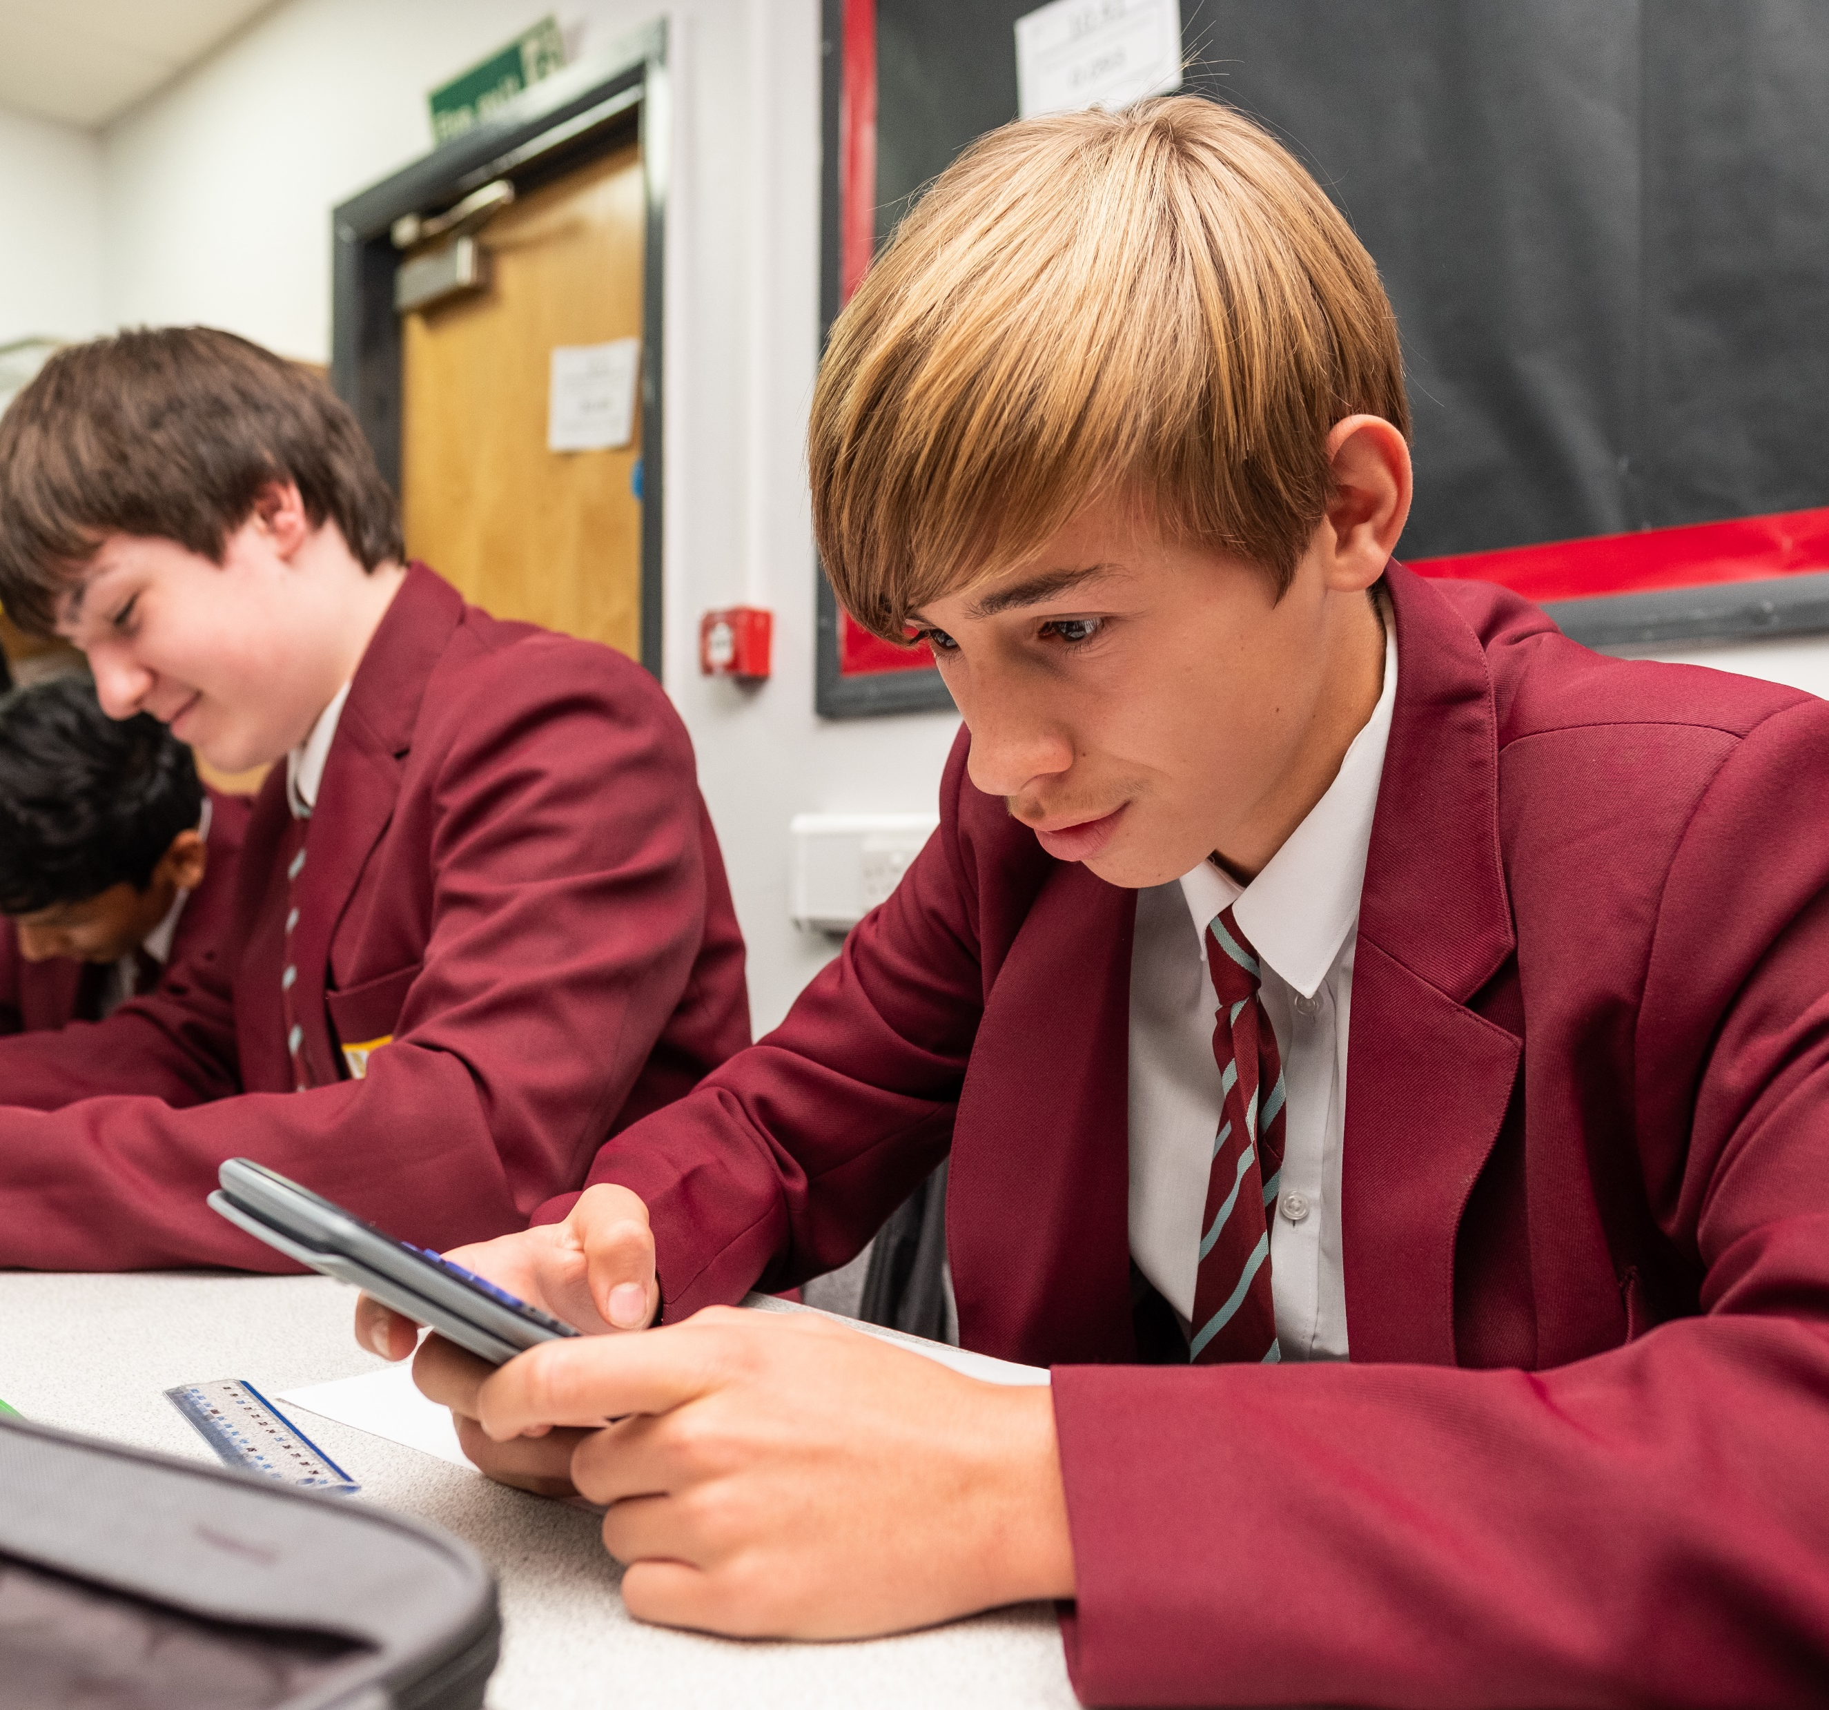
St Cuthbert’s is enjoying a period of exceptional growth and development, and we are looking for talented people from all backgrounds with a wide variety of skills, interests, and opinions to join our inclusive and welcoming community. Everyone at St Cuthbert’s is working to achieve our vision of ‘forming great men’. We are seeking to achieve that aim by promoting scholarship, by delivering excellence and by inspiring and celebrating commitment to service, both within and beyond the school community.
This is an opportunity to join our successful history department. The successful applicant will join a departmental team that strives to create the young historians of tomorrow, a team that ensures that our boys develop a breadth and depth to their historical knowledge. In History, we challenge our pupils to engage with a range of historical topics whilst developing key skills to be successful historians.
The history department is led by the head of history and is made up of four other members with a variety of experience and specialisms. We offer Edexcel GCSE History and AQA A level.
The successful candidate will learn from a team of history specialists who pride themselves at being at the forefront of developments within the subject. We take pride in our work with the examination boards and have been essential to the development of regional Network meetings. Our department also benefits from extensive support from across the Bishop Bewick Catholic Education Trust.
This is an opportunity to join a well-established and aspirational department in an impressive, all-boys Catholic School that has enjoyed a reputation as a centre of educational excellence for over one hundred years. We welcome applications from newly qualified teachers or early career entrants as well as, experienced history teachers looking for a new challenge.
The Role

Slide 10
The core purpose of every teacher at St Cuthbert’s Catholic High School is to inspire, motivate, encourage and educate the boys in our care. | Deputy Head: Pastoral (Behaviour and Attitudes)
Main Duties & Responsibilities | to raise standards of pupil attainment and achievement and monitor and support pupil progress to implement the school and department vision and development plan participate in the performance management process effectively implement all school policies and procedures to ensure behaviour is monitored and strategy is implemented across the department creatively enhance teaching in the department to ensure all documentation is consistently applied ensure all deadlines are met participate fully in school monitoring and evaluation process provide cover work in your absence
Teaching & Learning | teach high quality, engaging and inspiring lessons that promote pupil progress and foster a love of the subject plan and prepare lessons for all ability ranges, including the inclusion of appropriate differentiation to support and extend learning give clear targeted feedback and focused support give pupils maximum opportunity to make measurable progress participate in meetings at the school which relate to either curriculum or pastoral
Curriculum | ensure continuity and progression from KS2 to KS4 through to Post 16 education organise enrichment opportunities for pupils to extend their subject education outside of lesson time activities keep abreast of developments in all aspects of education as well as in the subject(s) in order to plan effectively
Assessment | participate and prepare pupils for public examinations assess, record and report on progress and attainment of pupils ensure that marking follows school marking policy guidance keep records of pupil progress and attainment meet deadlines for assessments and reports
The Role
continued

Slide 11
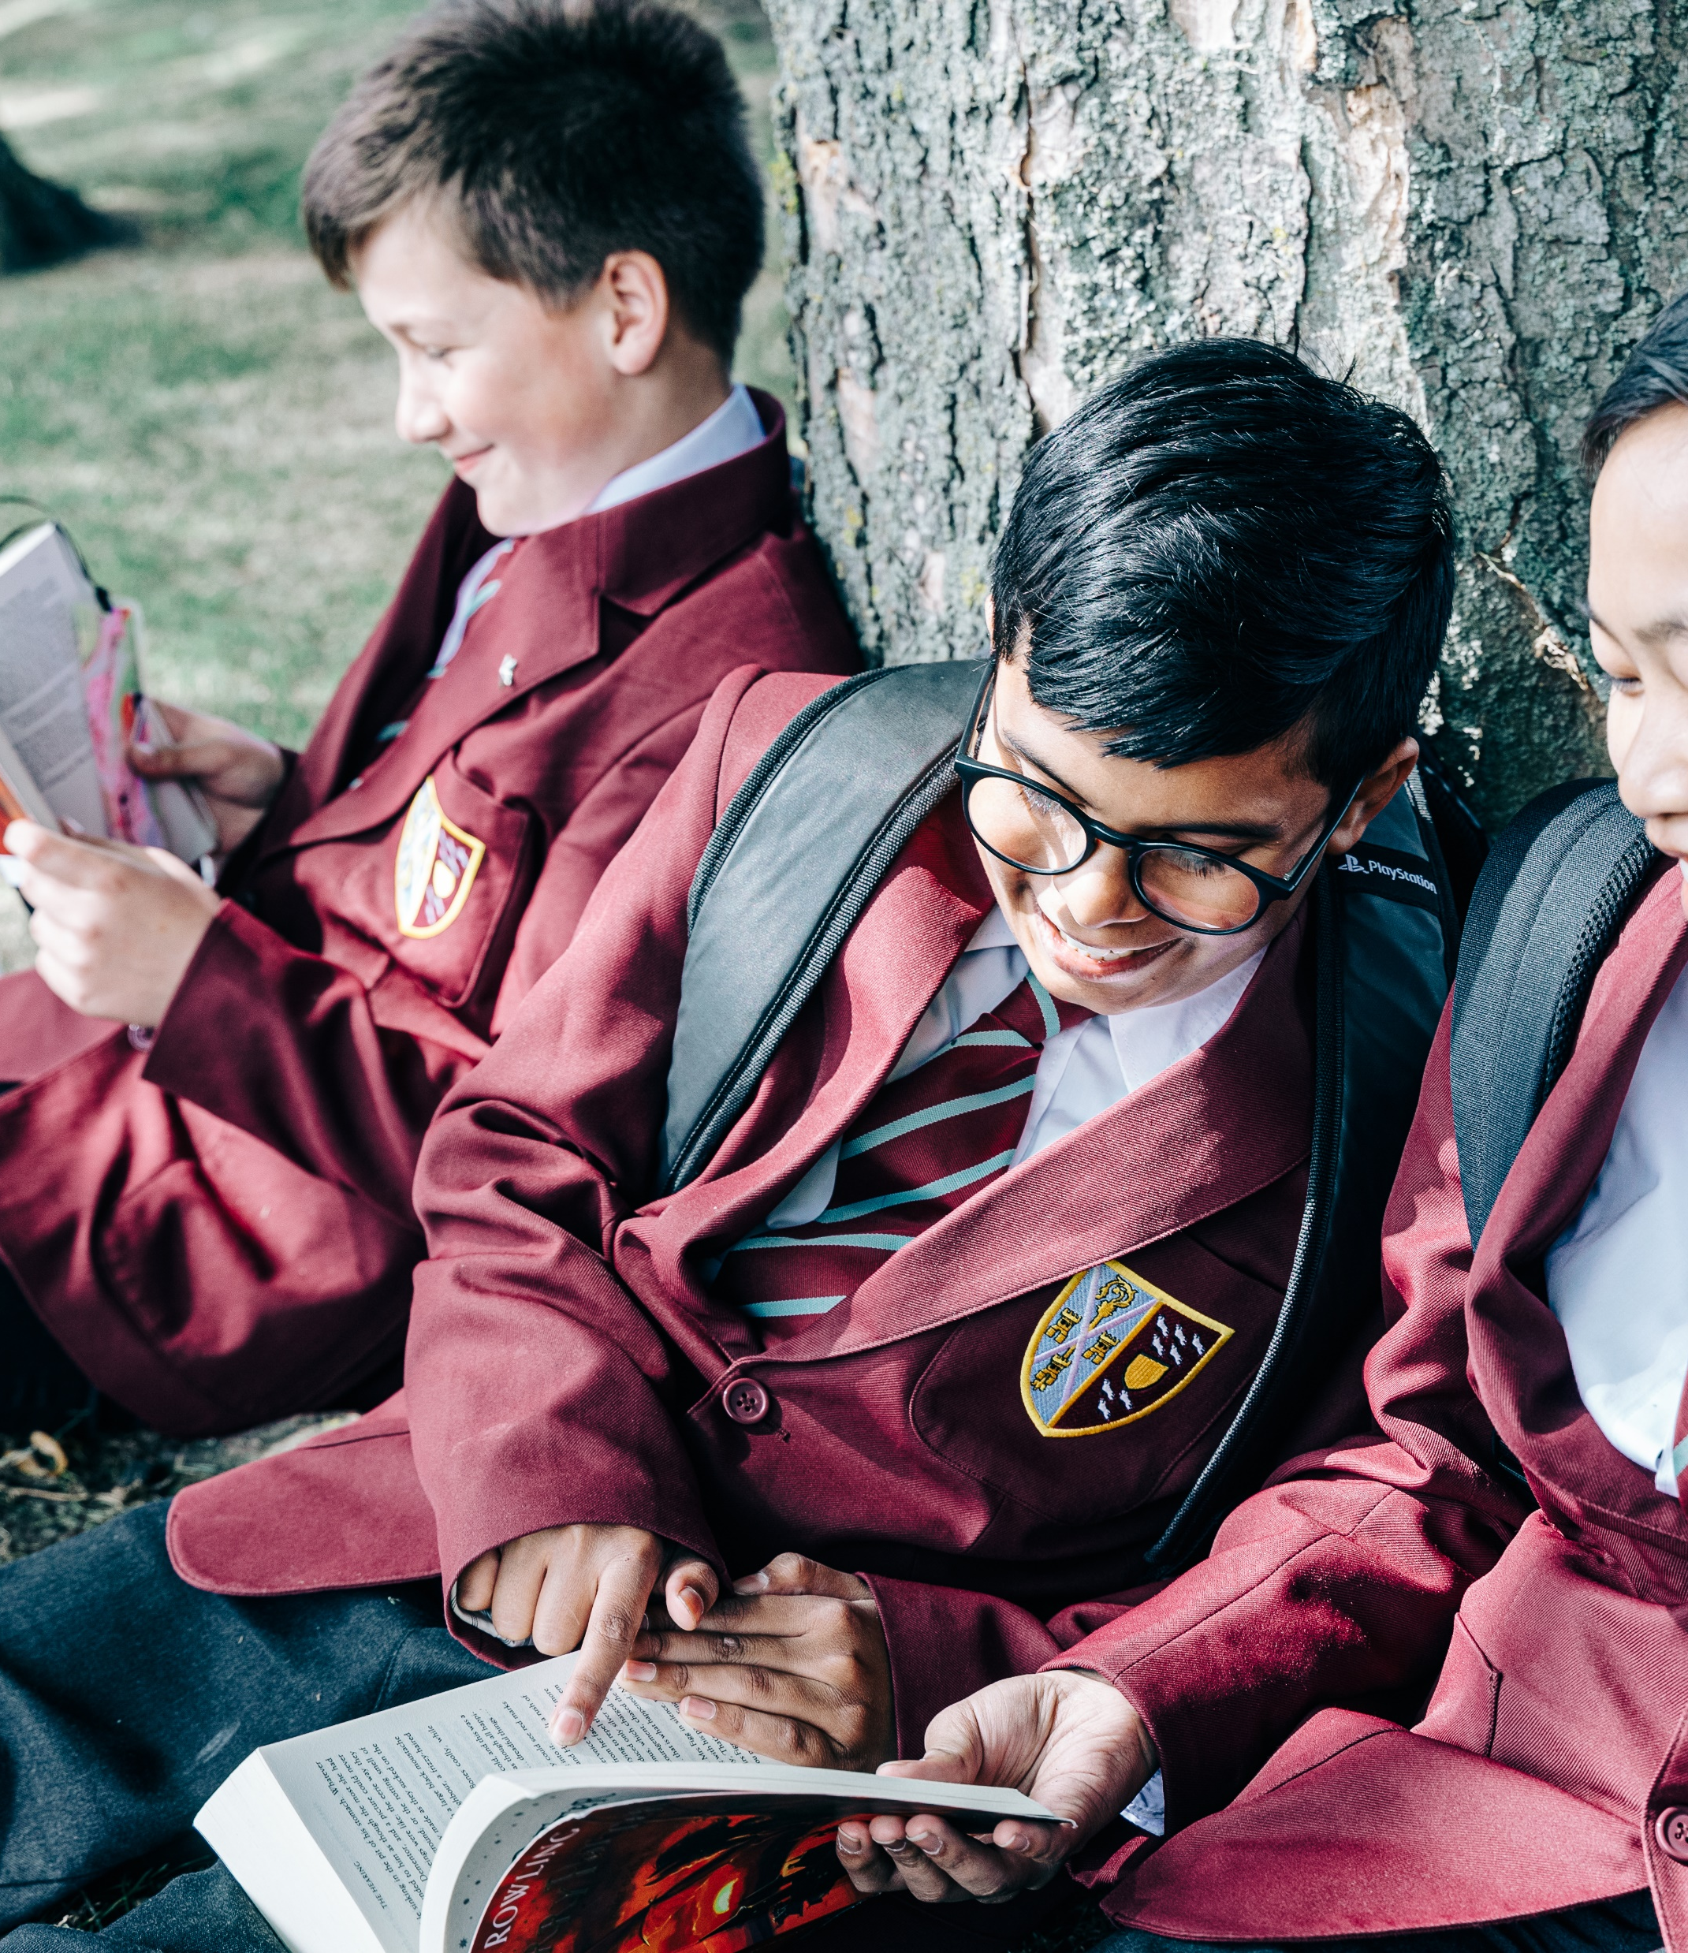
The Role Continued
Leadership | carry out and keep records of School Monitoring and Evaluation Policy ensure that all school deadlines are met and actions required by Headmaster are carried out fully
Performance Management and CPD | ensure adherence to Teacher Standards fulfil effectively your role as an appraiser where appropriate undertake any reasonable direction of Headmaster attend regular department and whole school meetings and CPD following school meeting calendar support the induction of new staff and take responsibility for newly qualified teachers and trainee colleagues
Resource Management | ensure that relevant Health and Safety legislation is followed manage and care for your room, reporting problems to the Business Manager ensuring the effective and efficient management and organisation of learning resources, including information and communications technology maintaining existing resources and exploring opportunities to develop or incorporate new resources into schemes of work ensuring that there is a welcoming, safe working and learning environment in which risks are properly assessed
Catholic Life of the School | to play a full part in the life of the school community, to support its distinctive Catholic vision and ethos and lead pupils to do the same to actively support the school’s corporate policies and aspirations to adhere to the staff professional code of conduct to comply with the School Health and Safety Policy and undertake necessary risk assessments
Pastoral Care | maintain good order in your classroom and subject area support colleagues in managing the behaviour of pupils studying the subject liaise with year leaders in promoting good behaviour in lessons and on the way to and from lessons attend assemblies and support the management of pupil entry and exit act as tutor to designated pastoral team
Other duties | to undertake an appropriate programme of teaching in accordance with the duties of a standard scale teacher to undertake any reasonable request of the Headmaster and accept any reasonably delegated additional responsibility from the Headmaster

Slide 12
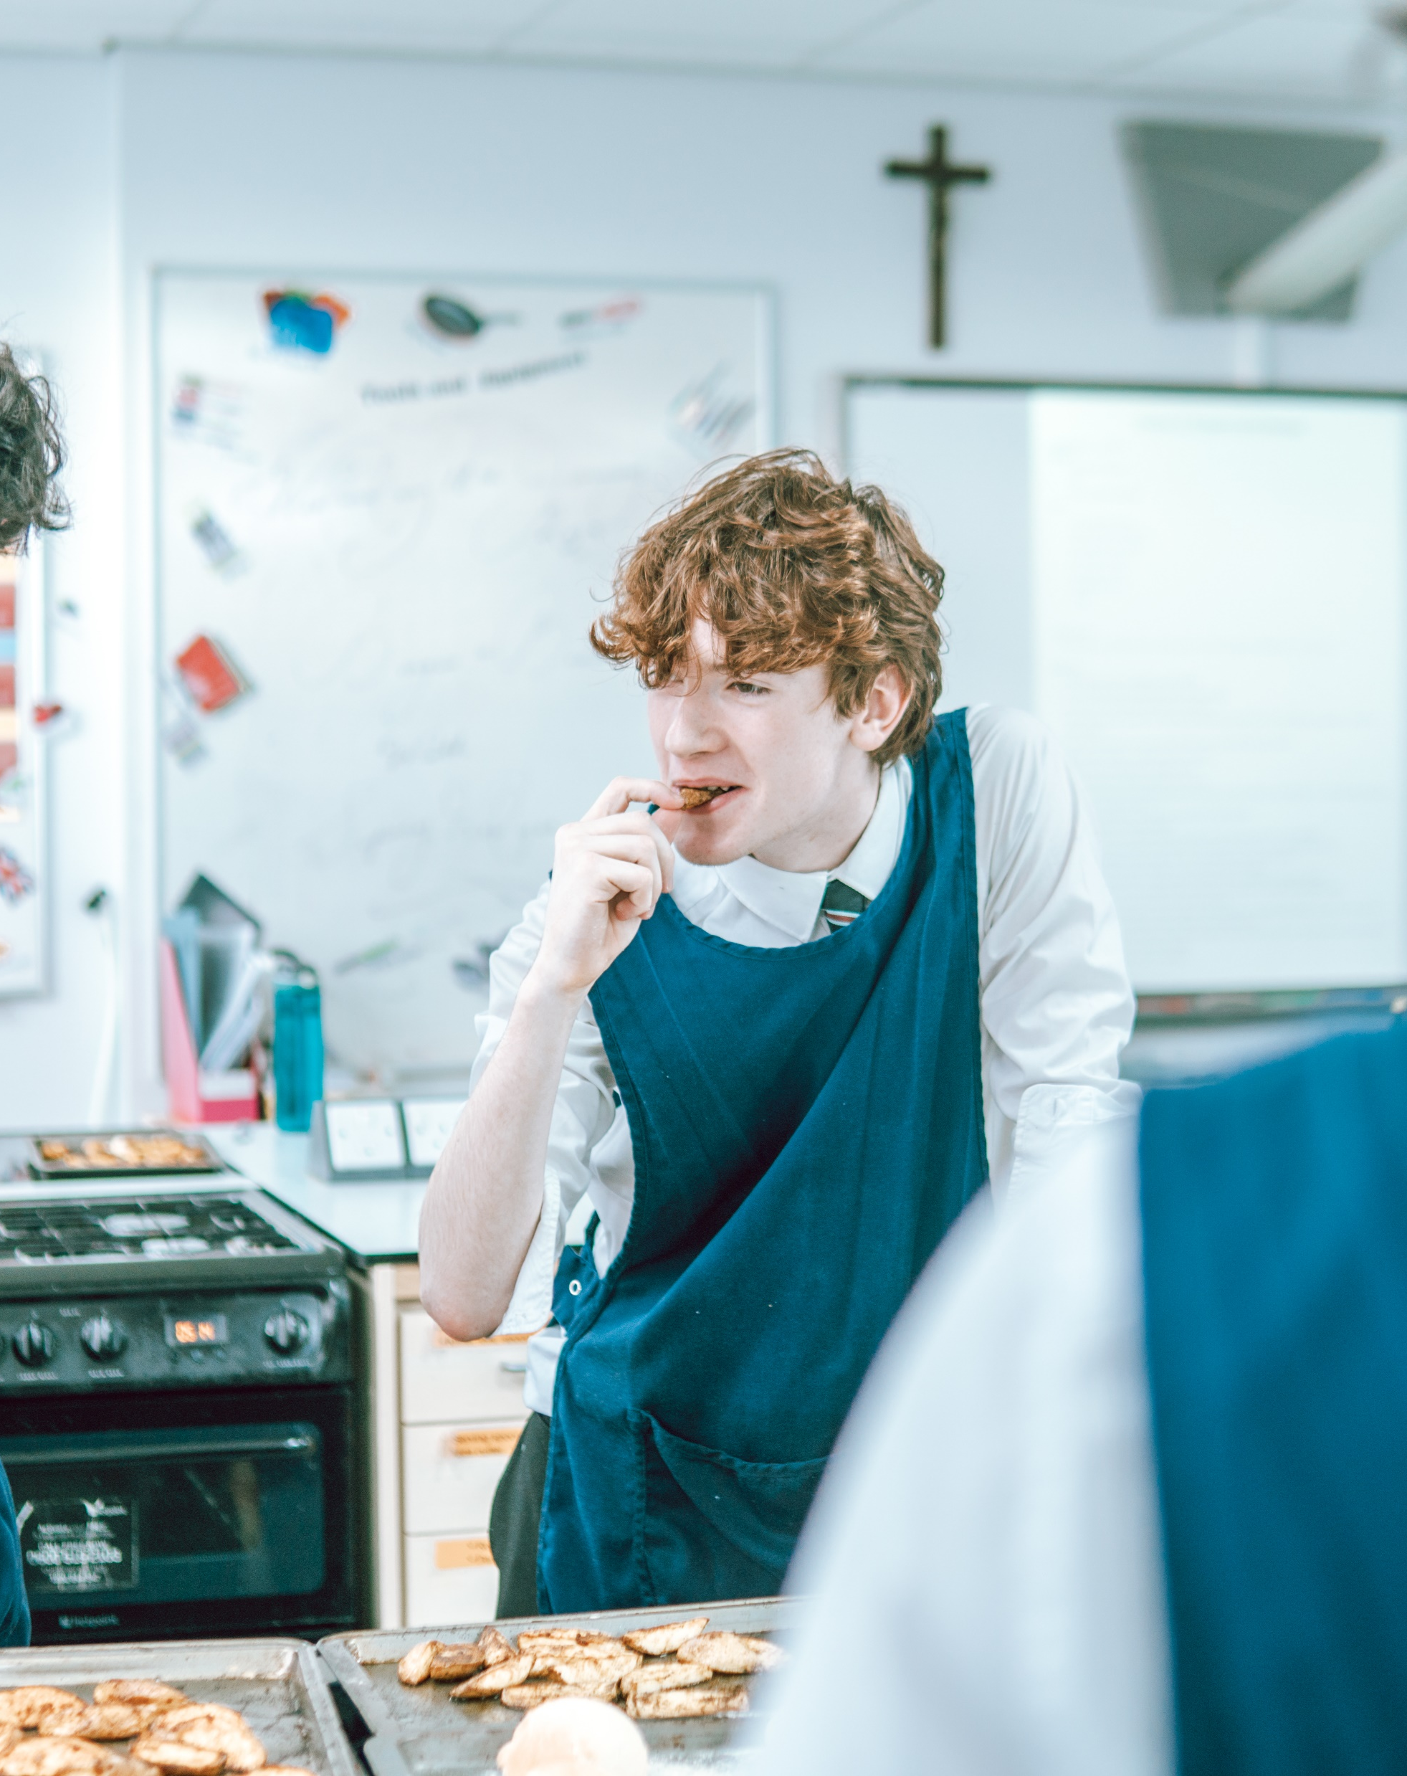
The person
Source Key: A = Application Form, I = Interview, R = References, CC = Checking Certificates
Faith Commitment | Essential | Desirable | Source
a practising Catholic (fulfilling the requirements of the Diocesan Briefing Note) |  | ✓ | A/I/R
secure understanding of the distinctive nature of the Catholic school and Catholic education |  | ✓ | A/I/R
understanding of the leadership role in spiritual development of pupils and staff |  | ✓ | A/I/R
involvement in parish community |  | ✓ | A/I/R
leading school worship |  | ✓ | A/I/R
Qualifications | Essential | Desirable | Source
Qualified teacher status | ✓ |  | A/CC
Relevant Degree | ✓ |  | A/CC
CCRS/CTC (or equivalent) or commitment to obtaining the certificate |  | ✓ | A/CC/I

Slide 13
The person continued
Experience and knowledge of teaching | Essential | Desirable | Source
experience of teaching in more than one school |  |  | A
able to teach high quality lessons at all Key Stages |  |  | A/I/R
sound understanding of planning and assessment |  |  | A/I/R
understanding and experience of being an effective team member |  |  | A/I/R
understanding of improving self and other and maintaining professional integrity even when under pressure |  |  | A/I/R
able to motivate and engage young people and colleagues |  |  | A/I/R
understanding of value of learning walls and other motivational materials |  |  | A/I/R
able to teach A Level |  |  | A/I/R
offer enrichment activity related to subject outside of the classroom to deepen the learning experience for students |  |  | A/I/R
marking / moderating for KS4 & KS5 |  |  | A/I/R
a proven track record of achieving best outcome for students |  |  | A/I/R
Personal Qualities | Essential | Desirable | Source
able to engage and inspire young people |  |  | A/I/R
genuine passion for the subject |  |  | A/I/R
a team player |  |  | A/I/R

Slide 14
The person continued
Personal Qualities | Essential | Desirable | Source
initiative/creativity |  |  | A/I/R
willing to learn with colleagues and young people |  |  | A/I/R
resilience – the ability to cope with competing demands and pressure |  |  | A/I/R
well-developed inter- personal skills |  |  | A/I/R
flexibility and the ability to adapt as circumstances change |  |  | A/I/R
Other requirements | Essential | Desirable | Source
application forms must be completed in full (including degree classification and post-16 qualification grades awarded) |  |  | A
supporting statement should be clear and concise and no more than 1,300 words |  |  | A
supporting statement should outline the experience, skills and attributes which you will bring to the post |  |  | A
Confidential References and Reports
only written references will be considered
references will confirm professional and personal knowledge, skills and abilities as referred to above
positive recommendation from current employer required
This job description is current at the date shown, but, in consultation with you, may be changed by the Headmaster to reflect or anticipate changes in the job commensurate with the grade and job title. Whilst every effort has been made to explain the main duties and responsibilities of the post, each individual task undertaken may not be identified and, therefore, this specification is not exhaustive. All employees are expected to be courteous to colleagues and provide a welcoming environment to visitors and telephone callers. In the best traditions of Catholic education, we seek to ‘welcome the guest as Christ himself, for He will say ‘I was a stranger and you made me welcome’ (Rule of St Benedict) and we recognise the intrinsic value all people. St Cuthbert’s Catholic High School will endeavour to make any necessary reasonable adjustments to the job and working environment to enable access to employment opportunities for disabled job applicants or continued employment for any employee who develops a disabling condition.

Slide 15
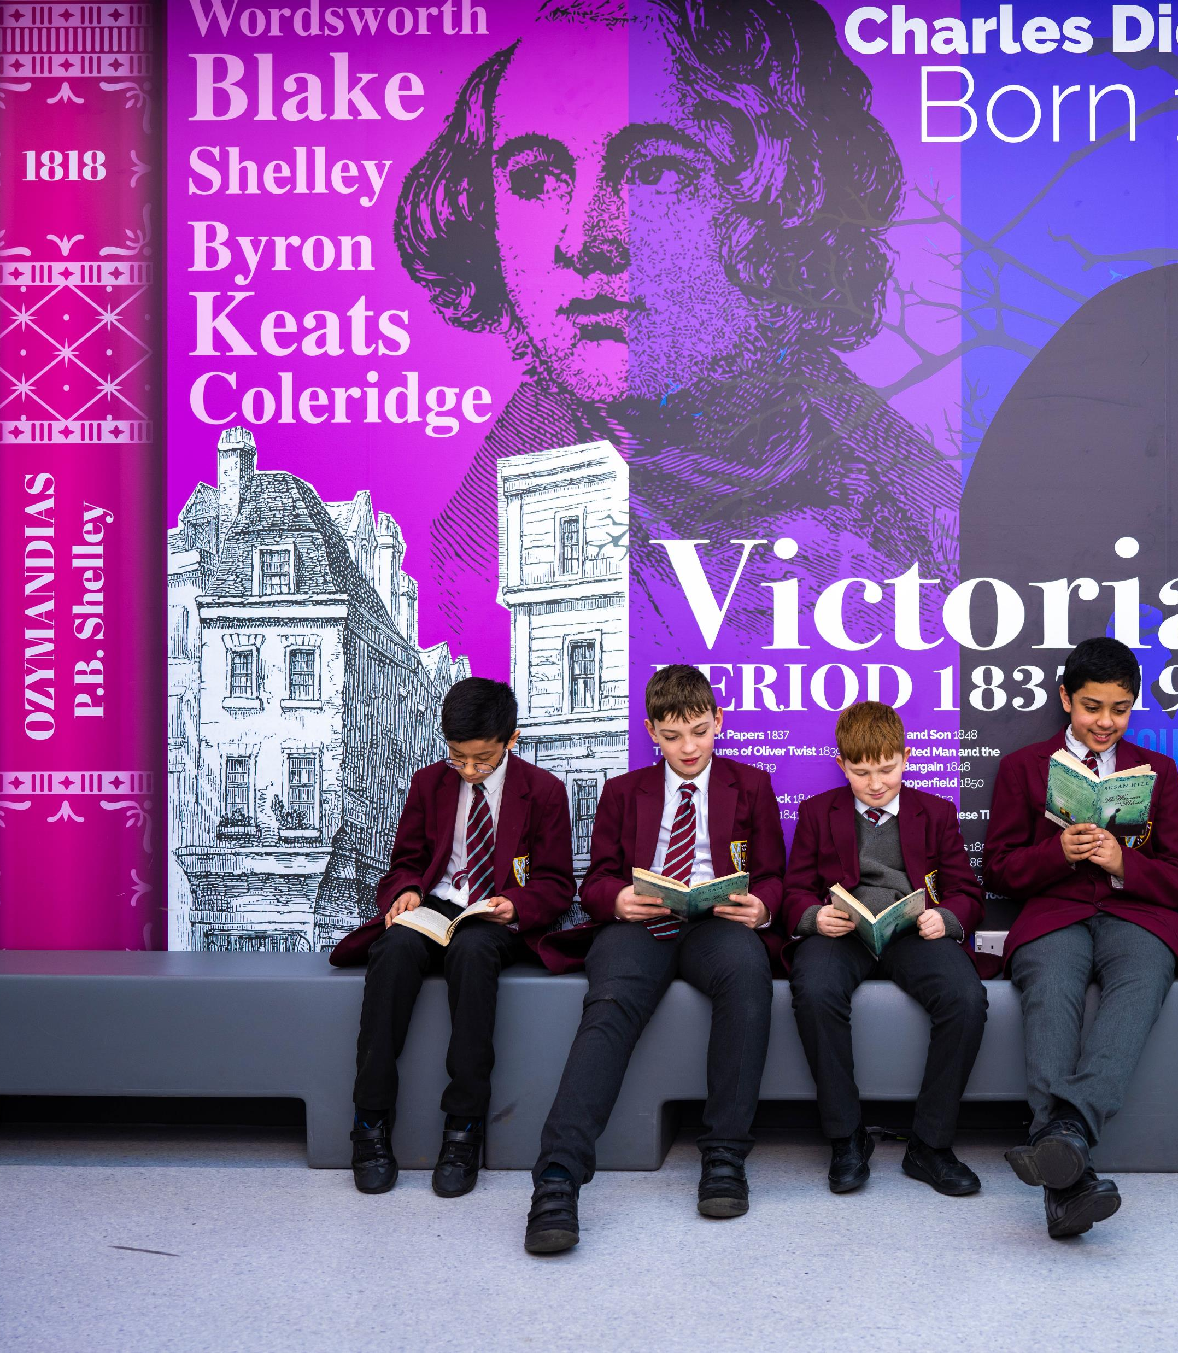
Our commitment to safeguarding
Any offer made to a successful candidate will be conditional upon relevant pre-employment checks, including:
two satisfactory references, one of which must be from your most recent employer
proof of identity, address and right to work in the UK
verification of relevant qualifications
candidates who have worked or been resident overseas for three months or more within the last five years will be subject to criminal record checks from the relevant jurisdiction(s)
confirmation that the applicant is not named on the Children’s Barred List, administered by the DBS
a satisfactory enhanced disclosure from the DBS. The applicant will be required to complete the application form for an Enhanced DBS Check and start dates will be delayed if a result is not received
candidates in managerial roles will be subject to a Prohibition from Management check.
Diversity: St Cuthbert’s Catholic High School and the Bishop Bewick Catholic Education Trust are fully committed to the principles of equal opportunity, diversity and inclusion. The Bishop Bewick Catholic Education Trust does not discriminate on the grounds of sex, disability, age, sexual orientation, marital status or racial ethnic or national origin and applications are welcome from a diverse range of backgrounds. As a Catholic school and an apostolate of the Roman Catholic Diocese of Hexham & Newcastle preference may be given to a practising Catholics.

Slide 16
Key Information
£



M1 £30,000 – UPS3 £46,525
If you wish to visit us or to arrange an informal conversation about this post, please contact Lynn Anderson on 0191 274 4510 or by emailing recruitment@scchs.org.uk
The closing date for applications is 9.00am Friday 10th May 2024.
(Interviews will be held on a date to be confirmed.)
The successful candidate will be contacted by telephone in the first instance and the appointment will subsequently be confirmed in writing. Unsuccessful candidates will be notified by telephone and by email; we will be willing to provide a debrief on request.

Slide 17
Application Process
Apply
Candidates should complete our Catholic Education Service Form which includes details of key achievements and experience. Completed forms should be returned to recruitment@scchs.org.uk
Shortlist
The hiring team will short-list the candidate based upon the information provided at application. Applicants will be assessed against the specifications provided. Those who best fulfil the criteria will be invited for interview.
Interview
The short-listed applicants will be invited to attend an interview. The interview process will consist of a variety of tasks to showcase your skills and experience.
Offer
The successful candidate will be made an offer as soon as is practicable after the interview date. Offers will be conditional, subject to satisfactory pre-employment checks.

Slide 18
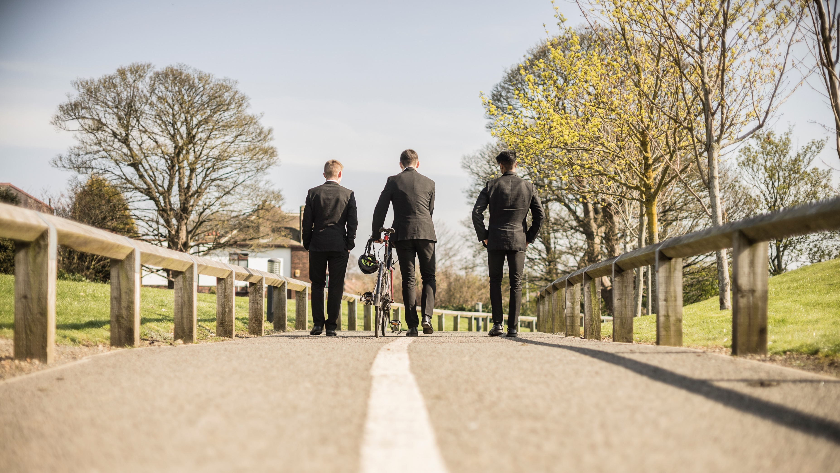
forming great men
St Cuthbert’s Catholic High School, Gretna Road, Newcastle-Upon-Tyne, NE15 7PX
Tel: 0191 274 4510 Email: admin@scchs.org.uk
www.scchs.org.uk
St Cuthbert’s Catholic High School is a member of the Bishop Bewick Catholic Education Trust. The Bishop Bewick Catholic Education Trust, is a company limited by guarantee registered in England and Wales. Company Registration No. 7841435. It is an apostolate of the Roman Catholic Church under the episcopal jurisdiction of the Bishop of Hexham & Newcastle. Registered Office: Fenham Hall Drive, Newcastle upon Tyne, NE4 9YH www

